Slide 1
Basics of Linux, Network and Authentication

Slide 2
Outline
IP Address & Port
Internet Connection
Domain Name Service
Secure Shell (SSH)
Public Key Authentication
SSH Configuration File
Miscellaneous of GCC Compiler

Slide 3
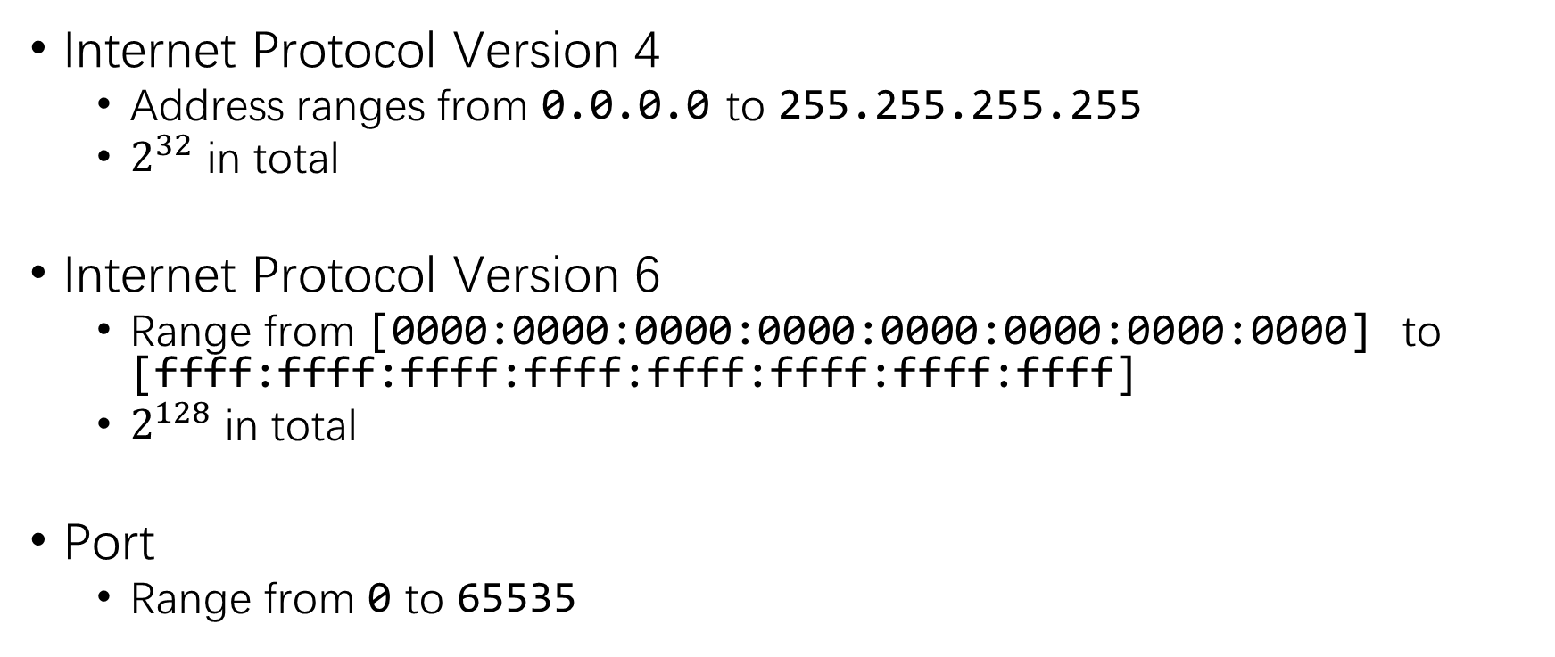
IP Address and Port
Internet Protocol Version 4
Address ranges from 0.0.0.0 to 255.255.255.255
$2^{32}$ in total
Internet Protocol Version 6
Range from [0000:0000:0000:0000:0000:0000:0000:0000] to [ffff:ffff:ffff:ffff:ffff:ffff:ffff:ffff]
$2^{128}$ in total
Port
Range from 0 to 65535

Slide 4
Connection
Connections are established between IP:Port pairs.
Eg:
Endpoint A 223.223.66.66:1123
Endpoint B 162.105.162.44:12598

Slide 5
Domain Name Service (DNS)
DNS
Server
www.example.com
93.184.216.34
Client
Web
Server
93.184.216.34 : 80

Slide 6
Secure Shell (SSH)
A SECURE connection between client and server.
Commands are forwarded to remote server, and outputs are retrieved back.
Can also be used as a means to transfer file. (sftp)

Slide 7
Secure Shell Continued
Commands to establish an SSH connection.
ssh [options] [user@]hostname [command]
Eg.:
ssh -p 1122 [mazhiyao@]162.105.31.220

Slide 8
Public Key Authentication
Public key encryption
A key pair consists of a public key and a private key.
The public key is used to encrypt data while the private one decrypt.
Plain
Text
Public Key
Cypher
Text
Private Key
Plain
Text
Notes:
Further reading: https://www.digitalocean.com/community/tutorials/understanding-the-ssh-encryption-and-connection-process

Slide 9
Public Key Authentication Continued
Keys cannot be reversely used.
Plain
Text
Private Key
???
Text
Cypher
Text
Public Key
???
Text
Note: Private key actually contains full information. Public key can be deduced from it.

Slide 10
Public Key Authentication Continued
How does SSH work with public key?
Upload the public key to the server.
Server randomly generate challenge string.
Server encrypt the string with public key, then send it to the client.
The client decrypts the string, and send it back to the server.

Slide 11
Public Key Authentication Continued
①
②
Plain
Str
Public Key
Cypher
Str
Server
④
③
Plain
Str
Private Key
Cypher
Str
Client

Slide 12
Cool, how to use it myself?
Generate your key pair.
ssh-keygen [--help]
Upload your public key to the server.
~/.ssh/authorized_keys
MUST have permission of 600 (rw- --- ---)
ssh-copy-id can be used, or do it manually.
Login!

Slide 13
Getting tired of repetitive typing?
Write your own SSH configuration file.
~/.ssh/config
Syntax:
Host ics
User mazhiyao
Hostname 162.105.31.220
Port 1022

Slide 14
I want my file uploaded.
Go and download FileZilla!
sudo apt install filezilla
sftp://162.105.31.220
NO! I want to be a geek.
scp [-r] [-P port] localFile [user@]addr:remoteFile
scp [-r] [-P port] [user@]addr:remoteFile localFile
scp thisFile ics:~

Slide 15
Miscellaneous of GCC Compiler
gcc [options] input1 input2 …
[-O0/-Og/-O1/-O2/-O3] : optimization
[-g] : debug
[-S] : compile to assembly
[-c] : compile to object file
[-o outputFile] : designate output file name

Slide 16
That’s all.

